Slide 1
01
MACHINE LEARNING WITH SCIKIT-LEARN
Introduction to
Machine Learning
What ML is, how it differs from classic programming, and your first model in five lines of scikit-learn.
Instructor: Shutchon Premchaisawatt
Master's Degree Program · Hands-on with Google Colab

Slide 2
AGENDA
Today's agenda
01
Why machine learning?
Problems rules can't solve
05
The ML workflow
From question to deployed model
02
ML vs classic programming
A different deal with the machine
06
scikit-learn & the estimator API
fit / predict / transform
03
AI vs ML vs Deep Learning
The map of the territory
07
First model in 5 lines
iris + KNeighborsClassifier
04
Three families of ML
supervised · unsupervised · reinforcement
08
Vibe coding for ML
prompting AI assistants well
Machine Learning with scikit-learn
SESSION 01 · 3

Slide 3
MOTIVATION
Why machine learning?
Some problems are easy for humans, hopeless for hand-written rules.
Spam filter
Write rules for every scam email? Scammers adapt overnight. Gmail learns from millions of labeled examples instead.
Will this customer churn?
Hundreds of interacting signals — tenure, contract, complaints, charges. No human can write that rule book.
Cat or dog?
You recognize them instantly, but can you write down how? This is the classic 'Polanyi's paradox'.
Common thread: we can't specify the rules — but we have many examples of the answers.
Machine Learning with scikit-learn
SESSION 01 · 4

Slide 4
THE CORE IDEA
Classic programming vs machine learning
CLASSIC PROGRAMMING
MACHINE LEARNING
Rules
written by you
→
+ Data
→
= Answers
Data
→
+ Answers
labels
→
= Rules
the model
We flip the arrow: instead of writing rules, we learn them from examples
A spam filter trained on 1M emails labeled “spam / not spam” produces a model — a compressed form of the rules. New email arrives → model predicts. You never wrote a single rule.
Machine Learning with scikit-learn
SESSION 01 · 5

Slide 5
WHAT IS MACHINE LEARNING?
“A computer program is said to learn from experience E, if its performance at task T,
measured by performance P, improves with E.”
— Tom Mitchell, Machine Learning (1997)
spam filter: T = classify emails · E = past labeled emails · P = % correctly classified
Machine Learning with scikit-learn
SESSION 01 · 6

Slide 6
THE MAP
AI ⊃ ML ⊃ Deep Learning
ARTIFICIAL INTELLIGENCE — machines doing “smart” things (1950s→)
This course = classical ML
scikit-learn's home turf
Tabular data: rows × columns
Trains in seconds, not hours
You can explain why it decided
  Deep learning → later course (fastai, PyTorch)
MACHINE LEARNING — learning rules from data (1980s→)
DEEP LEARNING — learning with multi-layer neural networks (2012→)
image & speech recognition · LLMs · self-driving · alpha-fold
this course: classical ML —
smaller data, tabular data,
interpretable, fast, and still
the workhorse of industry
Machine Learning with scikit-learn
SESSION 01 · 7

Slide 7
TAXONOMY
Three families of machine learning
Supervised
Learn from labeled examples: (X → y)
• Will it rain? (yes/no)
• House price? (number)
• Spam or not?
Most business ML lives here.
Unsupervised
Find structure, no labels given
• Customer segments
• Unusual transactions
• Compress 50 features → 2D
Session 07 covers this.
Reinforcement
Learn by acting & getting rewards
• Game-playing agents
• Robotics
• Recommendation loops
Out of scope — but you'll meet it again.
Machine Learning with scikit-learn
SESSION 01 · 8

Slide 8
SUPERVISED
Classification vs regression — know your y
Classification — y is a category
• churn: yes / no
• disease: benign / malignant
• email: spam / ham
• digit: 0–9
Output: a class label, sometimes with probability (79% spam)
Regression — y is a number
• house price: ฿4.2M
• demand next week: 1,240 units
• patient stay: 5.5 days
Output: a continuous value
(Watch out: “linear regression” is regression; “logistic regression” is classification!)
Choosing the family = reading your target column y. Everything else in sklearn follows from it.
Machine Learning with scikit-learn
SESSION 01 · 9

Slide 9
WORKFLOW
The ML workflow you'll repeat all course
1
Frame
what is y? what's success?
2
Collect & EDA
look at the data first
3
Prepare
clean, encode, scale
4
Train
fit a first quick model
→
→
→
5
Evaluate
on data it never saw
6
Tune
hyperparameters, features
7
Error analysis
where & why it fails
8
Communicate
insights, not just scores
→
→
→
Sessions map 1:1 onto this loop: 02–03 = prepare · 04 = evaluate · 05–07 = train & tune · 08 = all of it.
Machine Learning with scikit-learn
SESSION 01 · 10

Slide 10
TOOLING
scikit-learn — one library, the whole workflow
Inside sklearn | what it gives you
Datasets | iris, wine, breast cancer, …
Preprocessing | impute, encode, scale (S02–03)
Models | linear, trees, ensembles, clustering (S05–07)
Model selection | train/test split, CV, grid search (S04, 07)
Metrics | accuracy, F1, ROC, RMSE, R² (S04)
Why practitioners love it
One consistent API for ~everything
Excellent docs & tutorials (scikit-learn.org)
Plays well with pandas
Not for: deep learning, huge data
  (this course = classical ML, so perfect fit)
Machine Learning with scikit-learn
SESSION 01 · 11

Slide 11
THE ONE API
Every model: fit() → predict()
model = Model(hyperparams)
create — no data yet
→
model.fit(X_train, y_train)
learn from examples
→
y_pred = model.predict(X_test)
apply to new data
works for ANY sklearn model
Transformers too
scaler.fit(X) → learn the stats
scaler.transform(X) → apply
  fit_transform() = both at once
Consistency is why sklearn won: learn the API once, use 50+ models.
model = KNeighborsClassifier(n_neighbors=3)
model = DecisionTreeClassifier(max_depth=4) # swap the model,
model = RandomForestClassifier() # keep the rest:
model.fit(X_train, y_train) # same 3 lines
model.predict(X_test)
Machine Learning with scikit-learn
SESSION 01 · 12

Slide 12
DATASET
Meet the iris dataset (1936!)
from sklearn.datasets import load_iris
X, y = load_iris(return_X_y=True) # 150 flowers × 4 features
X = features (4 columns)
measurements — the inputs
y = target (1 column)
species 0/1/2 — the answer
Goal: predict species from measurements → classification
y | sepal L | sepal W | petal L | petal W
0 | 5.1 | 3.5 | 1.4 | 0.2
0 | 4.9 | 3.0 | 1.4 | 0.2
1 | 7.0 | 3.2 | 4.7 | 1.4
2 | 6.3 | 3.3 | 6.0 | 2.5
150 flowers · 3 species (0=setosa, 1=versicolor, 2=virginica) · 4 measurements in cm
Machine Learning with scikit-learn
SESSION 01 · 13

Slide 13
MOMENT OF TRUTH
Your first model — five lines
from sklearn.model_selection import train_test_split
from sklearn.neighbors import KNeighborsClassifier
X_train, X_test, y_train, y_test = train_test_split(
X, y, test_size=0.3, random_state=42) # ① hold out 30%
model = KNeighborsClassifier(n_neighbors=3) # ② create
model.fit(X_train, y_train) # ③ learn
print(model.score(X_test, y_test)) # ④ judge
100% right
on flowers it never saw
  score() on the TEST set — the model never trained on it
  Iris is gently easy. Real data (Titanic, next session) won't hand you 100%.
1.0
Machine Learning with scikit-learn
SESSION 01 · 14

Slide 14
KEY HABIT
Never grade a student on questions it has seen
TRAINING SET — 70% · model.fit() sees this
TEST — 30%
↓
↓
fit → learn patterns
The model adjusts itself to minimize mistakes on the training set. Like studying with the answer key.
score → honest exam
Test questions were never shown. This number estimates real-world performance.
random_state=42 makes the split reproducible — same split on every machine. Full story in Session 04.
Machine Learning with scikit-learn
SESSION 01 · 15

Slide 15
INSPECT
Look at what it got wrong
model50 = KNeighborsClassifier(n_neighbors=50).fit(X_train, y_train)
y_pred = model50.predict(X_test)
compare = pd.DataFrame({"actual": y_test, "predicted": y_pred})
compare[compare.actual != compare.predicted] # only the misses
actual | predicted
2 | 1
2 | 1
k=50 → 2 misses out of 45: virginica (2) predicted as versicolor (1)
These two species overlap in measurements — even humans misjudge them
Error analysis (S07) = reading these misses systematically
predict() returns labels; predict_proba() returns probabilities
Machine Learning with scikit-learn
SESSION 01 · 16

Slide 16
UNDER THE HOOD
KNN in 30 seconds — “you are like your neighbors”
versicolor
setosa
To classify a new point:
① find its k nearest training flowers
② let them vote on the species
k=3 here → 2× versicolor wins
k is a hyperparameter — YOUR choice before training
small k: flexible, noisy · large k: stable, bland
?
← new flower
virginica
Machine Learning with scikit-learn
SESSION 01 · 17

Slide 17
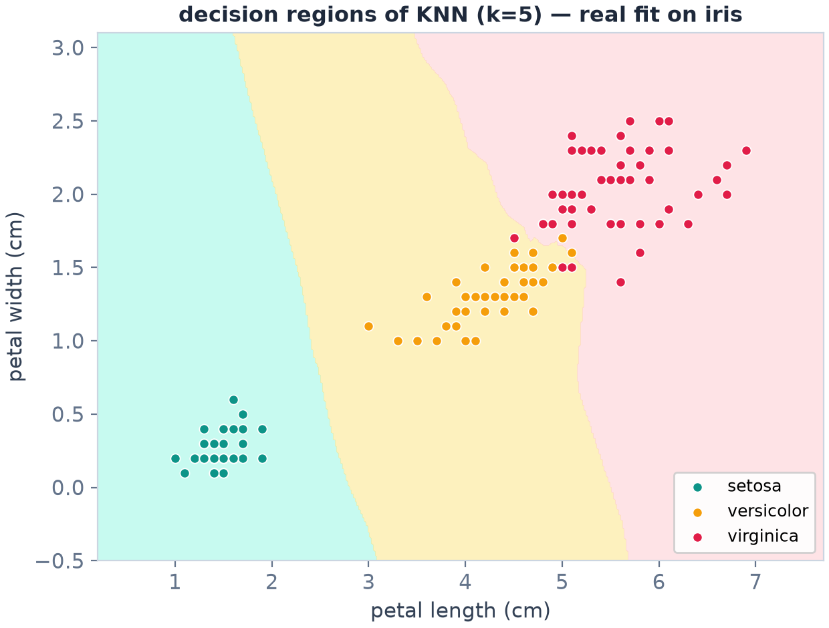
UNDER THE HOOD
What KNN actually learns — decision regions
The model IS this map
every point in the plane inherits its neighbors' vote
the wiggly border = KNN's local, memory-based nature
k small → wigglier · k large → smoother (S04 measures it)
real fit: iris, petal length × width, k=5
in 30 features it's the same idea — we just can't draw it
Machine Learning with scikit-learn
SESSION 01 · 18

Slide 18
EXPERIMENT
Turn one knob, watch the score move
for k in [1, 3, 5, 15, 50]:
m = KNeighborsClassifier(n_neighbors=k)
m.fit(X_train, y_train)
print(f"k={k:2d} accuracy={m.score(X_test, y_test):.3f}")
Iris is easy — every sane k is perfect
so we crank k until it breaks:
k=50 → too blunt
votes drown the local pattern (underfitting)
On messier data the right k matters a lot — picking it properly = cross-validation, Session 04
k= 1 accuracy=1.000
k= 3 accuracy=1.000
k= 5 accuracy=1.000
k=15 accuracy=1.000
k=50 accuracy=0.956
Machine Learning with scikit-learn
SESSION 01 · 19

Slide 19
CHEAT SHEET
Which model when? (simplified sklearn map)
Situation | Start with | Then try | Session
Few rows, need explainability | Linear / Logistic Regression | Decision Tree | 05 / 06
Tabular, want best accuracy | RandomForest / HistGradientBoosting | XGBoost, LightGBM | 06
Small clean data, smooth boundaries | KNN | SVM (RBF) | 06
No labels — find groups | KMeans | DBSCAN, PCA | 07
Text features | TfifVectorizer + LogisticRegression | naive_bayes | —
Full interactive map: scikit-learn.org → “choosing the right estimator”.
Machine Learning with scikit-learn
SESSION 01 · 20

Slide 20
VIBE CODING
Prompting AI for ML code that actually works
CONTEXT
pandas df, columns, dtypes
→
GOAL
what you want to predict
→
CONSTRAINT
sklearn, no leakage, reproducible
→
VERIFY
check vs docs / run it
a prompt that works
Why this works:
names dtypes → encoder choice is right
“Pipeline” → leakage-safe by design
“CV” → honest estimate, no test leakage
Then verify: imports real? params real?
I have a pandas DataFrame `df` with columns
tenure(float), contract(object), monthly_charges(float),
churn(0/1 int). Using scikit-learn only:
1) build a ColumnTransformer that imputes+one-hot-encodes
contract and scales the numeric columns,
2) chain it with LogisticRegression in a Pipeline,
3) evaluate with 5-fold stratified CV — mean ROC-AUC.
Random-state 42. Do NOT touch a holdout test set.
Machine Learning with scikit-learn
SESSION 01 · 21

Slide 21
VIBE CODING
Four ways an AI assistant will lie to you
Invented API
sklearn.magic.AutoML(...) doesn't exist. LLMs interpolate plausible names. Paste into an editor and it fails — trust only what runs.
Silent leakage
“I improved your accuracy!” — by fitting the scaler on ALL data or scoring on the training set. Always ask: what did fit() see?
Deprecated args
train_test_split(train_size=0.7, test_size=0.7)? graphviz syntax changed? APIs move. Check the version in the docs.
Metric confusion
accuracy on a 99%-negative problem looks like 99%. LLMs rarely warn you. Session 04 gives you the questions to ask.
Defense: run it, read it line by line, and check anything unfamiliar against scikit-learn.org.
Machine Learning with scikit-learn
SESSION 01 · 22

Slide 22
LAB 01 · DO IT IN GOOGLE COLAB
โมเดลแรกของคุณ — First model, your hands
YOUR MISSION (โจทย์ภาษาไทยใน Colab)
Learning goal
Train, score and inspect your own KNN model on real data — and transfer the pattern to a new dataset.
โหลด iris แล้วแบ่ง train/test 70:30 (random_state=42)
เทรน KNeighborsClassifier (k=3) และรายงานคะแนนบนชุดทดสอบ
รันเปลี่ยน k ∈ {1,3,5,15,50} — ผลลัพธ์เปลี่ยนอย่างไร?
สร้างตารางเทียบ actual vs predicted แล้วหาแถวที่ทายผิด
โจทย์ชวนคิด: ทำซ้ำทั้งหมดกับ wine dataset (load_wine) โดยไม่ดูเฉลย
Vibe coding corner
ลองถาม AI: “อธิบายว่าทำไม k=50 ให้คะแนนแย่กว่า k=3” แล้วตรวจสอบคำตอบกับสไลด์หน้า 17 — AI อธิบายเหตุผลได้ดี แต่คุณต้องเป็นคนตัดสินว่าเชื่อไหม
Machine Learning with scikit-learn
SESSION 01 · 23

Slide 23
KEY TAKEAWAYS
1. ML learns rules from (data + answers) — for problems you can't hand-code.
2. Supervised = learn X→y; classification (category) vs regression (number).
3. sklearn's one API: create → fit() → predict() — same 3 lines for every model.
4. Always split train/test: score on data the model never saw.
5. AI assistants accelerate you — verify APIs, watch for leakage, explain every line.
NEXT
Session 02 — Data Understanding & Cleaning — real data is messy
Machine Learning with scikit-learn
SESSION 01 · 24

